Slide 1
Performance Analysis of
Machine Leaning Approaches
in Stroke Prediction
Tegar Ridwansyah

Slide 2
INTRODUCTION

Slide 3

Every year fifteen million people are suffering from stroke in worldwide
and affected individuals are passing away every 4-5 minutes
- World Health Organization (WHO)

Slide 4
A stroke is a medical emergency that requires rapid treatment
Problem:
Early detection and adequate therapy are necessary to limit future damage to the affected area of the brain as well as other complications in the body.
Solution:
Finding a machine learning model that is able to make early predictions of stroke symptoms that appear.

Slide 5
RESEARCH METHODOLOGY

Slide 6
Dataset: Stroke Prediction Dataset (Kaggle)
The data contains 5110 observations with 12 attributes.
Id : unique identifier
Gender : Male, Female, and Other
Age : age of patient
Hypertension : 0 (doesn’t have any) and 1 (has)
Heart_disease : 0 (doesn’t have any) and 1 (has)
Ever_married : No and Yes
Work_type : Children, Govt_jov, Never_worked, Private, and Self-employed
Residence_type : Rural and Urban
Avg_glucose_level : average glucose level in blood
Bmi : body mass index
Smoking_status : formerly smoked, never smoked, smokes, and unknown
Stroke : 0 (doesn’t have any) and 1 (has)

Slide 7
In this experiment, we will use nine machine learning classifiers which we used to build stroke predictors.
Logistic Regression
Stochastic Gradient Descent
Decision Tree
AdaBoost
Gaussian
Multilayer Perceptron
KNeighbors
Gradient Boosting
eXtreme Gradient Boost
The reason for selecting these classifiers is that they are well-known classifiers for generating vulnerability predictors and have been utilized in numerous similar research studies.

Slide 8
Implementation Procedures
1. Input Data
2. Data Preprocessing
3. Imbalance Dataset
4. Split Data
Data from Kaggle
Check missing value and duplicate.
Missing value filled up by median.
Labeling for categorical column and normalize for numerical column.
Oversampling technique
Split data for training and testing
5. Base Algorithms
6. Weighted Voting
7. Model Optimization
Take nine algorithms as a base algorithm to train and test proposed approach
Implement weighted voting classifier to improve accuracy of all the classifiers
Confusion matrix is measured to find out the value of accuracy, auc, FP rate, and FN rate.

Slide 9
RESULTS

Slide 10
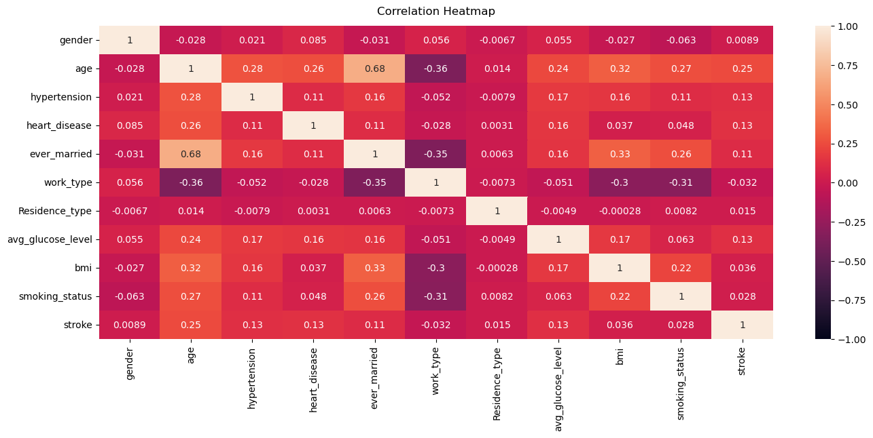
Correlation Results
Among the metrics gender, age, hypertension, heart disease, ever married, residence type, avg glucose level, bmi, and smoking status have respectably high effect on stroke. The least effect factor is work type.

Slide 11
Performance Analysis
Table 1
Classifier Name | Predicted → | No Stroke (0) | Stroke (1)
 | Actual ↓
Logistic Regression | No Stroke (0) | 644 | 329
 | Stroke (1) | 311 | 661
Stochastic Gradient Descent | No Stroke (0) | 349 | 624
 | Stroke (1) | 60 | 912
Decision Tree | No Stroke (0) | 936 | 37
 | Stroke (1) | 0 | 972
AdaBoost | No Stroke (0) | 719 | 254
 | Stroke (1) | 96 | 876
Gaussian | No Stroke (0) | 725 | 248
 | Stroke (1) | 194 | 778
Multilayer Perceptron | No Stroke (0) | 734 | 239
 | Stroke (1) | 139 | 833
Kneighbors | No Stroke (0) | 849 | 124
 | Stroke (1) | 0 | 972
Gradient Boosting | No Stroke (0) | 767 | 206
 | Stroke (1) | 78 | 894
eXtreme Gradient Boost | No Stroke (0) | 933 | 40
 | Stroke (1) | 0 | 972
Weighted Voting | No Stroke (0) | 946 | 27
 | Stroke (1) | 0 | 972
Table 1 represents confusion matrices of the stroke prediction using nine different classifiers, namely: LR, SGD, DTC, AdaBoost, Gaussian, MLP, KNeighbors, GBC, XGB and weighted voting classifier for measuring the performance of stroke prediction.

Slide 12
Performance Analysis
Table 2
Classifier Name | Accuracy | AUC | FP Rate | FN Rate
Logistic Regression | 67% | 0,67 | 33,23 | 32,57
Stochastic Gradient Descent | 65% | 0,65 | 40,63 | 14,67
Decision Tree | 98% | 0,98 | 3,67 | 0
AdaBoost | 82% | 0,82 | 22,48 | 11,78
Gaussian | 77% | 0,77 | 24,17 | 21,11
Multilayer Perceptron | 81% | 0,81 | 22,29 | 15,92
Kneighbors | 94% | 0,94 | 11,31 | 0
Gradient Boosting | 85% | 0,85 | 18,73 | 9,23
eXtreme Gradient Boost | 98% | 0,98 | 3,95 | 0
Weighted Voting | 99% | 0,99 | 2,70 | 0
In Table 2, after applying nine classifiers, this experiment use a weighted voting classifier to evaluate the results and measure the accuracy value and auc value, which is 99% for other classifiers, 98% for DT and XGB classifiers, and 94% for Kneighbors classifier. This experiment achieve the lowest accuracy from the SGD classifier, 65%.
A greater FN rate shows that the model generates false alarms. In terms of false positive and false negative rates, weighted voting classifier is the best predictor among the techniques tested.

Slide 13
CONCLUSION

Slide 14
Nine classifiers were utilized to determine the performance of a person's stroke occurrence. To predict stroke, the suggested weighted voting classifier used features such as gender, age, hypertension, heart disease, ever married, residence type, avg glucose level, bmi, and smoking status. Weighted voting outperformed other machine learning methods with an accuracy rate of approximately 99%.
As a result, weighted voting can be used to forecast a stroke. This experiment investigated the link between these disorders and the risk of a stroke happening in a human. So, if we can manage this condition at an early stage, we will be able to limit the number of strokes in our lives.

Slide 15
THANK YOU
Reference
Emon, M. U., Keya, M. S., Meghla, T. I., Rahman, M. M., Mamun, M. S. A., & Kaiser, M. S. (2020). Performance Analysis of Machine Learning Approaches in Stroke Prediction. 2020 4th International Conference on Electronics, Communication and Aerospace Technology (ICECA). doi:10.1109/iceca49313.2020.9297525

